Slide 1
Golang Appengine

Slide 2
hello world

Slide 3
https://cloud.google.com/appengine/docs/go/gettingstarted/introduction

Slide 4
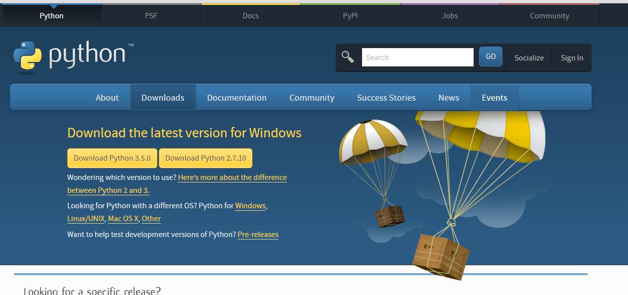

Slide 5
Install App Engine SDK
https://cloud.google.com/appengine/downloads#Google_App_Engine_SDK_for_Go

Slide 6
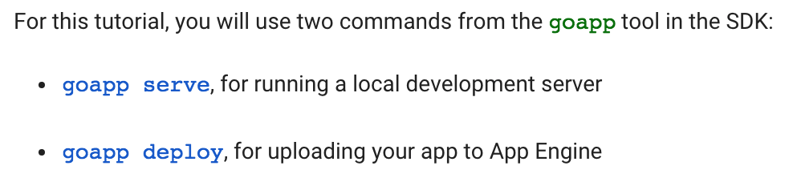

Slide 7
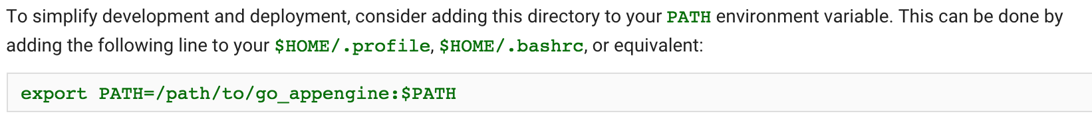

Slide 8
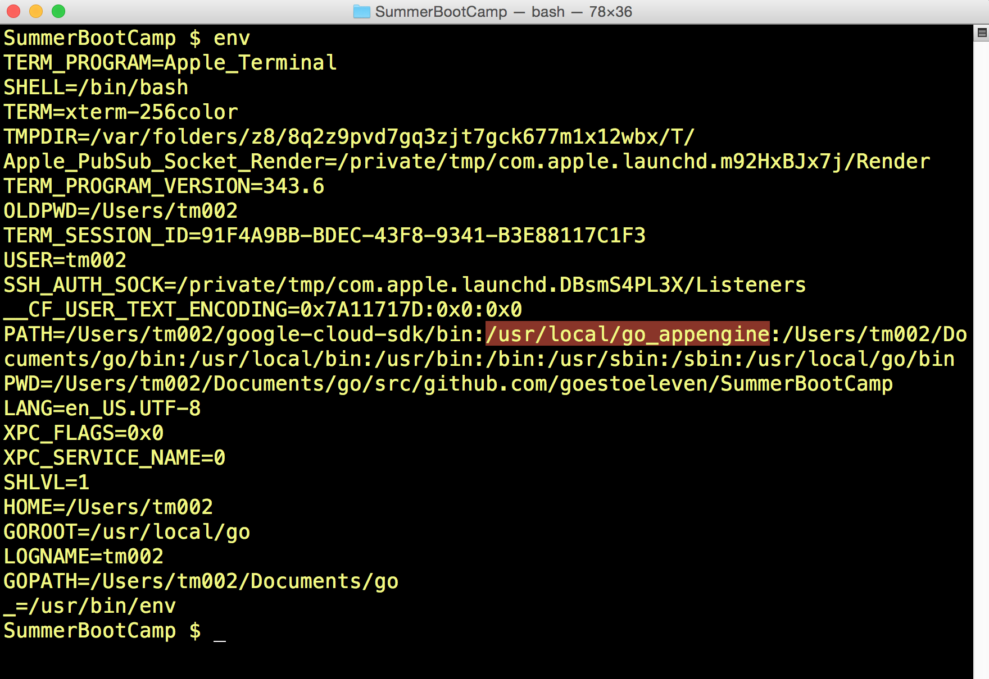

Slide 9
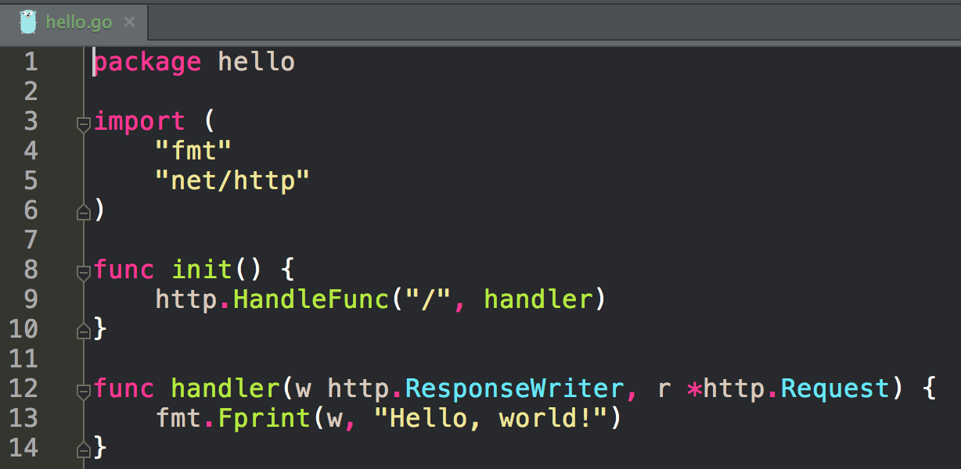

Slide 10
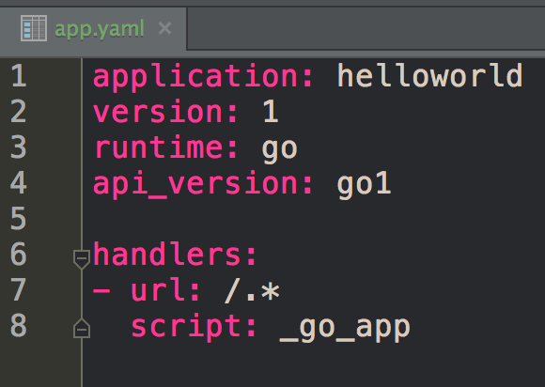

Slide 11
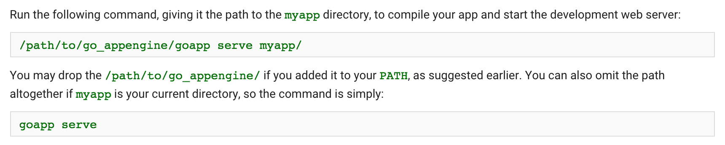

Slide 12
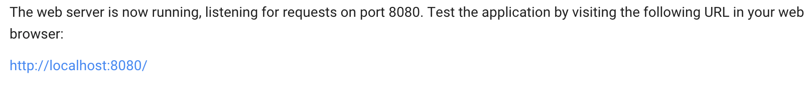

Slide 13
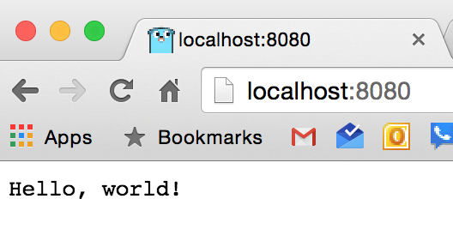

Slide 14
ctrl + c
stops goapp serve

Slide 15
photo blog

Slide 16
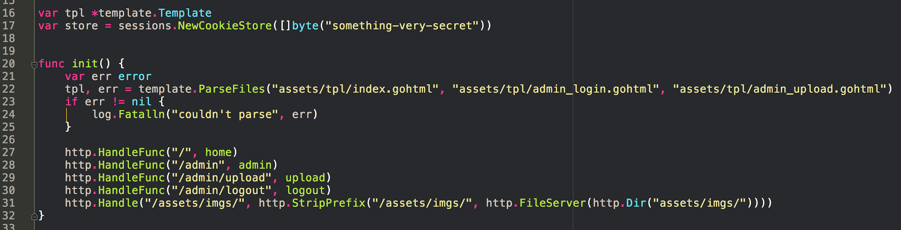
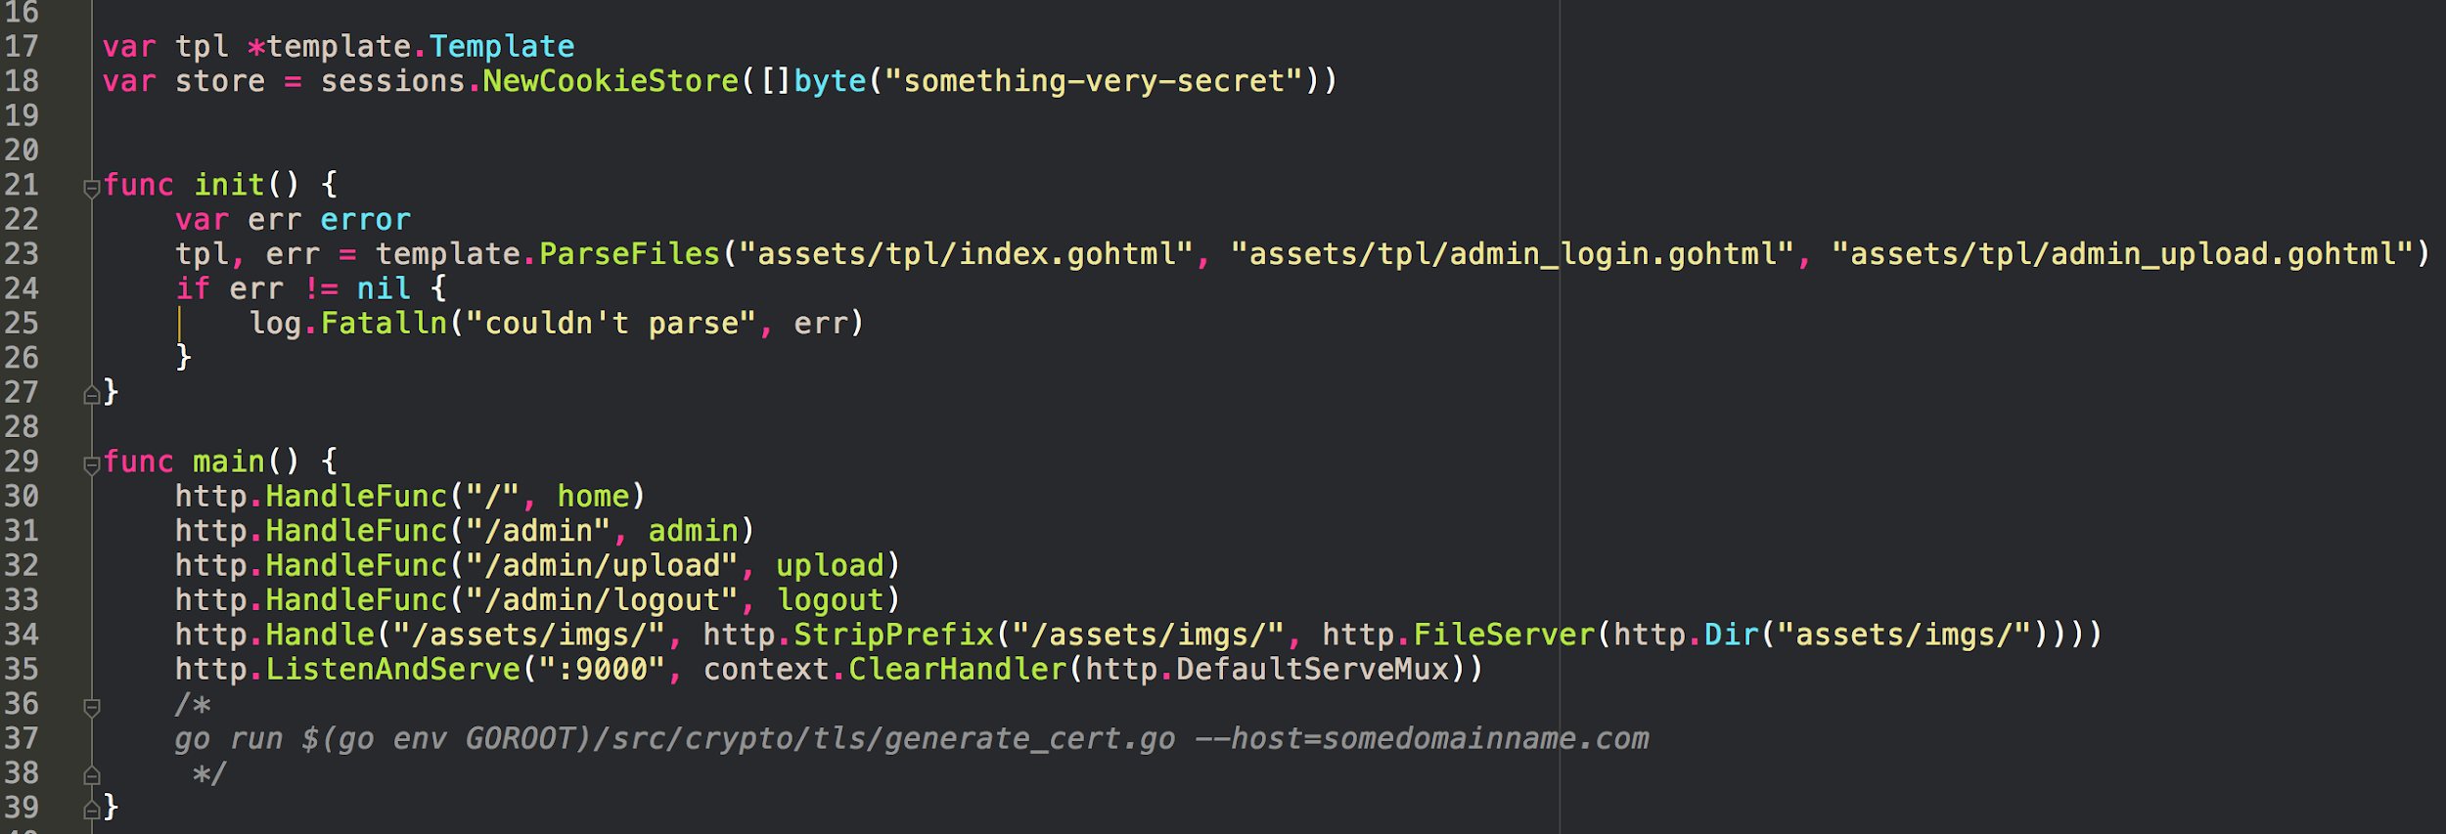
App Engine:
no main; use init instead
no http.ListenAndServe

Slide 17
App Engine:
no main; use init instead
no http.ListenAndServe
I also changed:
package name (from main to photos)
file name (from main to photos)

Slide 18
deploying

Slide 19
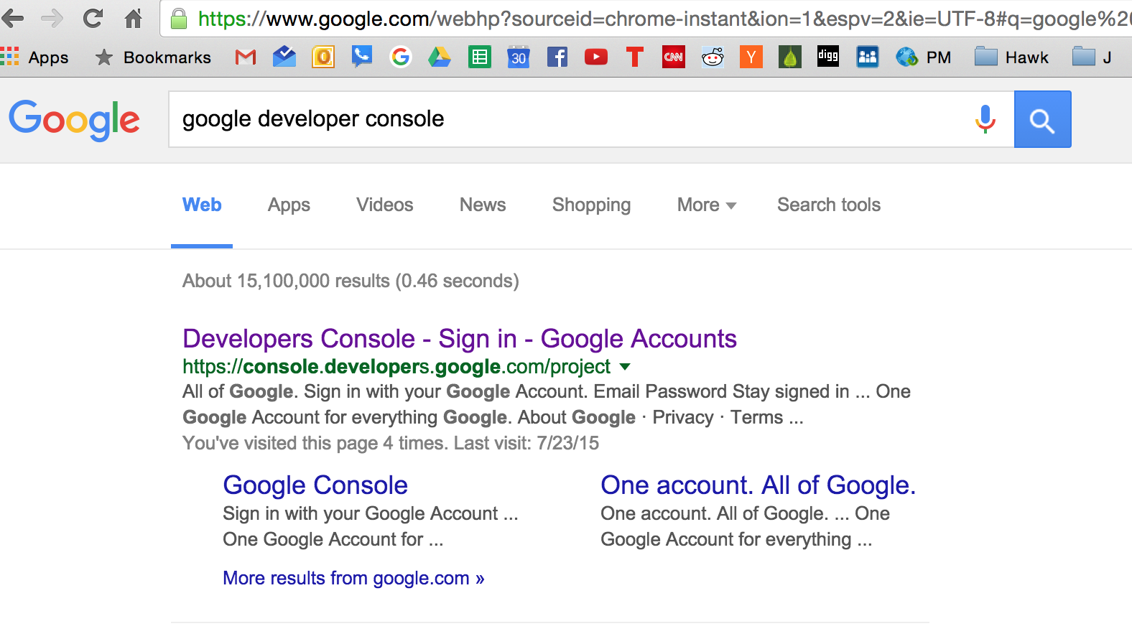

Slide 20
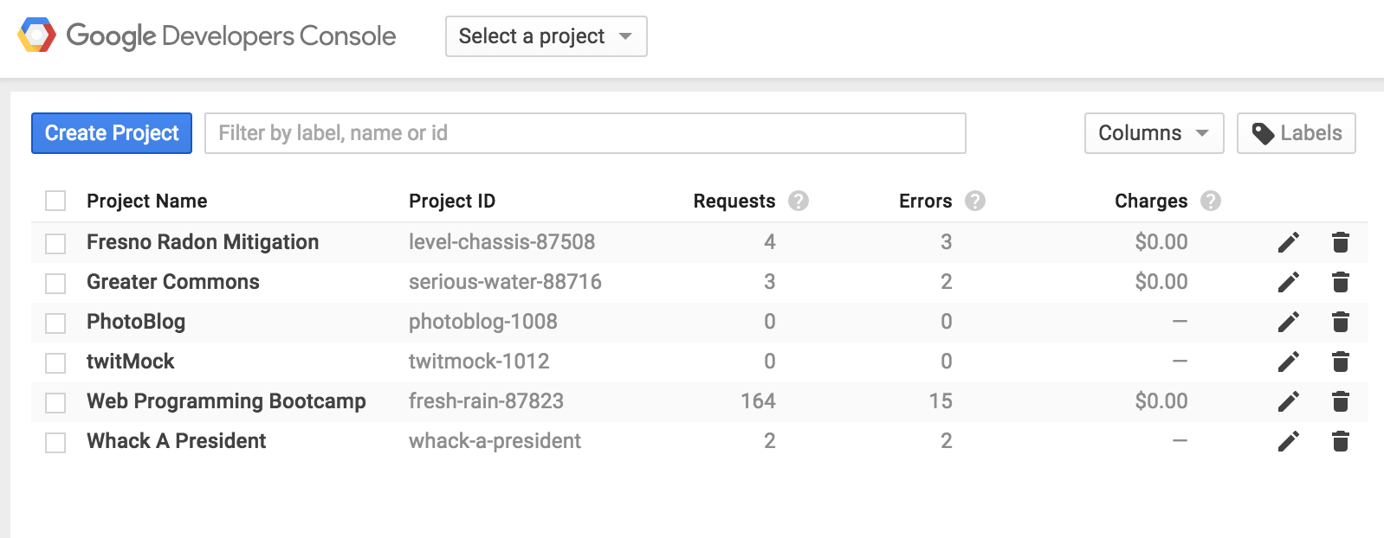

Slide 21
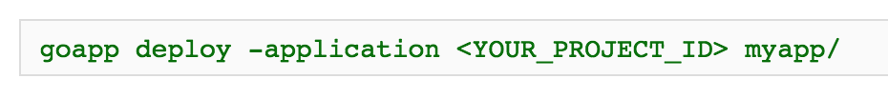

Slide 22
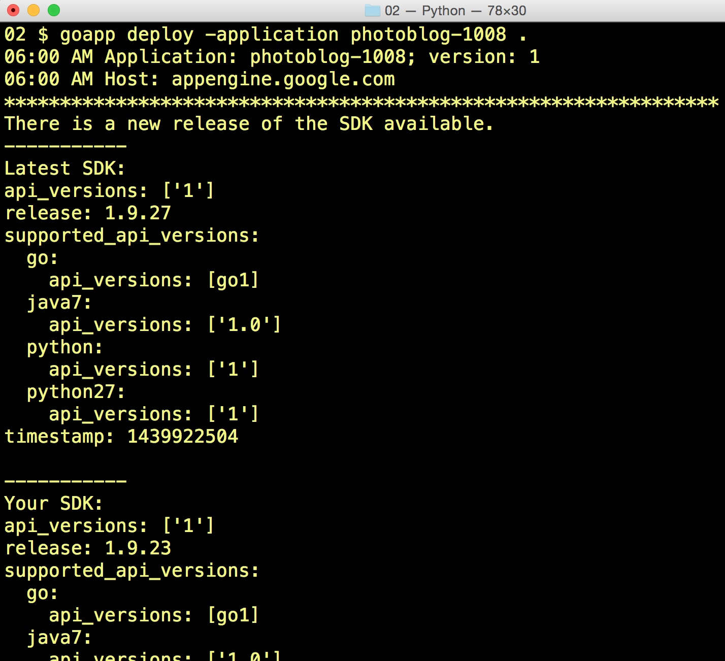
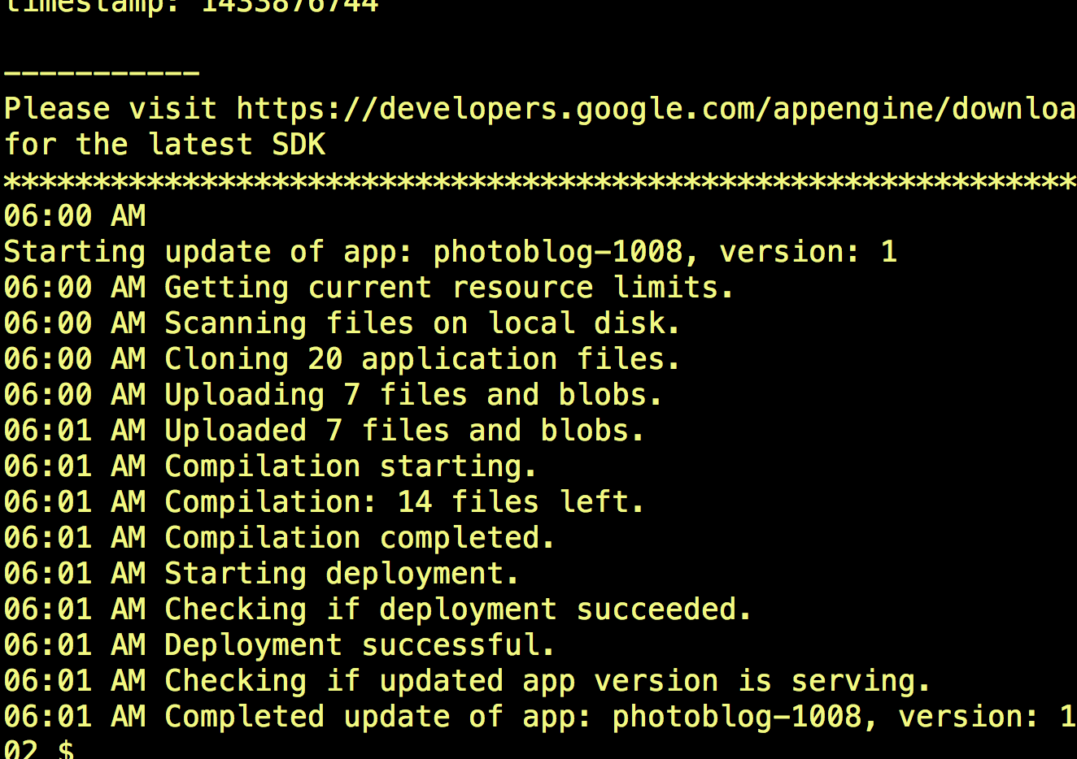

Slide 23
two step auth
https://support.google.com/accounts/answer/185833

Slide 24


Slide 25
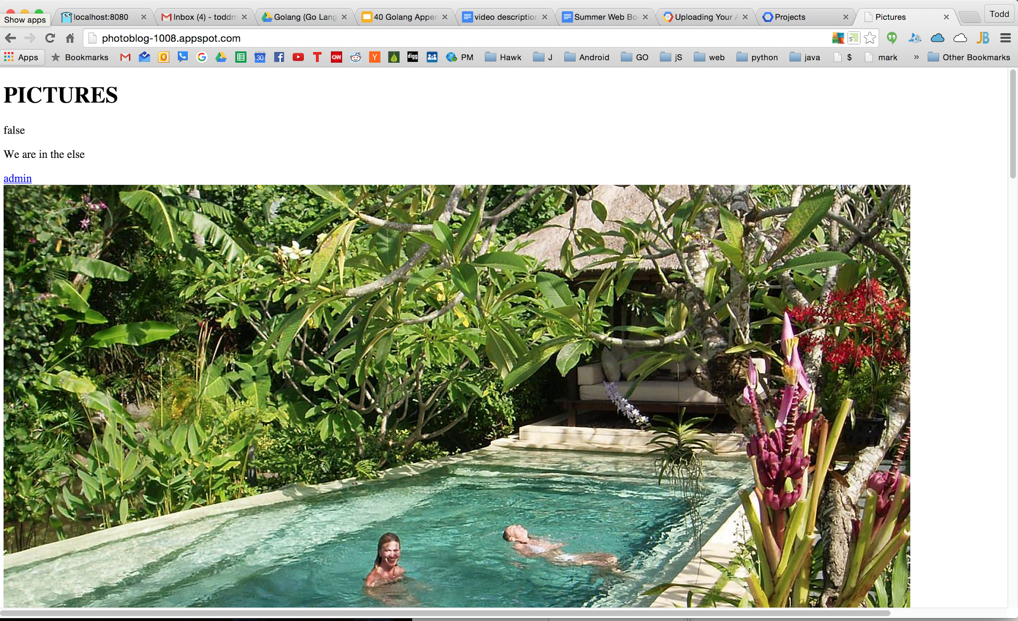

Slide 26
google domains & app engine

Slide 27
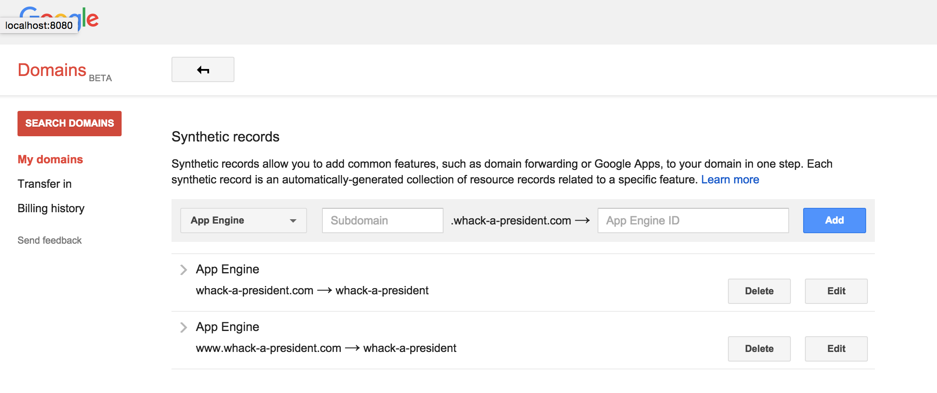

Slide 28
